Slide 1
Domain Adaptation
Ansh Bajpai (AM.SC.U4AIE23108)
Nishant Shah (AM.SC.U4AIE23166)

Slide 2
Problem Statement
Unsupervised Domain Adaptation Is used in many machine learning applications, which aims to adapt classifier trained on a labelled source domain to unlabelled target domain. Many existing approaches first learn domain invariant features then use them to construct classifiers for them .But due to domain shifts, a classifier that has been trained on a source domain to discriminate between objects based on their distribution, seems to struggle when trying to classify the data from a different distribution. This issue is prevalent in fields such as computer vision(CV) and natural language processing(NLP).

Slide 3
Motivation
With rapid advancements in domain adaptation techniques, through this paper we systematically categorize and analyse notable contribution across various domain adaptation approaches , analysing their impact on model generation and it’s effectiveness. We use techniques like discriminative clustering, Support Vector Machine (SVM), eXtreme Gradient Boosting (XGBoost), Correlation Alignment (CORAL), Maximum Mean Discrepancy (MMD) and few additional techniques or approaches. In Conclusion we explore the evolution of these methods , discuss their real word application and provide an evaluation of their future potential for improving cross domain adaptation task across different application areas.

Slide 4
Dataset
Datasets | Explanation
MNIST | MNIST is a classic dataset of handwritten digits, containing grayscale images of digits from 0 to 9. It was designed for benchmarking image classification models, especially in the early days of deep learning. Each image is 28×28 pixels, centered and clean, making it a simple yet powerful baseline for domain adaptation tasks
Caltech-256 | Caltech 256 contains 30,607 images spread across 256 object categories plus one background category. The dataset was created to improve object recognition benchmarks by offering more variability than Caltech 101. Each class has at least 80 images with varying viewpoints, lighting, and sizes.
Office-31 | Office-31 is a standard benchmark dataset for domain adaptation, containing 4,110 images across 31 categories. It comprises three domains: Amazon (web images), DSLR (high-quality camera), and Webcam (low-resolution). It helps evaluate models in domain shift scenarios like adapting from online product images to real-world photos.
MNIST-M | The MNIST-M dataset is a modified version of the original MNIST dataset, designed for domain adaptation research. It consists of grayscale handwritten digit images (0–9) from MNIST, but with added colored backgrounds and noise patterns. This makes it more challenging and suitable for testing models' ability to generalize across domains

Slide 5
Methodology
We have used many machine learning classification techniques in our project and have taken inferences from them based on the visual plot and calculated accuracy. These methods will be used to improve classification accuracy and reduce domain shifts across datasets like Office-31 and Caltech-256 and would include applying these techniques to MNIST-M, focusing on adapting the models to handle the domain shift, with particular attention to image-based features and classification challenges posed by the colored backgrounds.
K Nearest Neighbour Logistic Regression
SVM Naive Bayes
Decision Tree Random Forest
Stacking Classifier Auto Encoder
Grid Search CV CNN
XG Boost PCA
LDA T-SNE
CORAL MMD

Slide 6
Work Completed – Using Mnist and Mnist-M
I implemented several machine learning models, including SVM, Logistic Regression, Naive Bayes,
CNN, Decision Trees, and Random Forest, on both the MNIST and MNIST-M datasets.
For model evaluation, I used various metrics like accuracy, recall, precision, and F1-score.
I also visualized the results through techniques such as PCA, LDA, and t-SNE to
reduce the dimensionality of the data and better understand the model's performance.
To further assess the model performance, I calculated per-digit accuracy, generated confusion
matrices, and visualized the distribution of predictions.
I compared how each algorithm performed on both datasets, and this gave me valuable
insights into which model performed best for different types of data.
K Nearest Neighbour
Logistic Regression
SVM
Naive Bayes
Decision Tree
Random Forest
PCA
T-SNE
LDA
CNN
valuation Metrics:
Accuracy
Recall
Precision
F1-Score
Model Performance Analysis:
Per-Class Accuracy: For each digit class, I calculated the accuracy and visualized it
Confusion Matrix: I created a confusion matrix to assess the model's classification performance across all classes.
Distribution of Predictions: further I visualized the distribution of predictions across classes .

Slide 7
Work Completed – using Office -31
Using the Office-31 dataset we have been able to measure the accuracy and visualize the predicted labels and are successful to some extent. The approach that we have followed is that we have used all the dataset and converted it into a csv file which contains all the features and where the images are reduced to pixels which help in proper data processing .
After successfully creating the individual csv files for each domain(amazon, webcam and dslr) we have applied PCA and CORAL for the feature alignment process.
On Office-31 dataset the following techniques have been implemented and the results have been inferred and visualized.
K Nearest Neighbour
Logistic Regression
SVM
Naive Bayes
Decision Tree
Random Forest
PCA
T-SNE

Slide 8
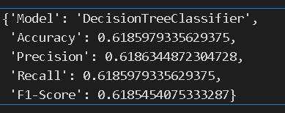
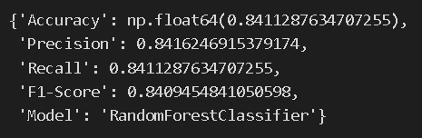
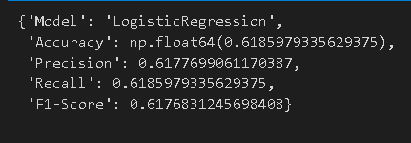
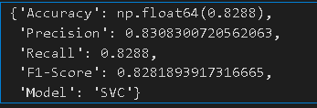
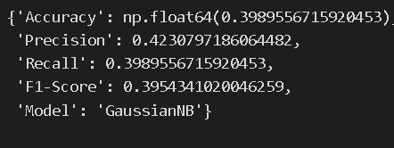
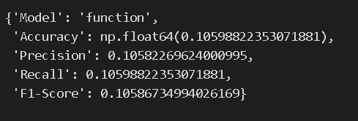
Results – Mnist - M
KNN

Slide 9
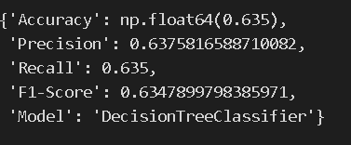
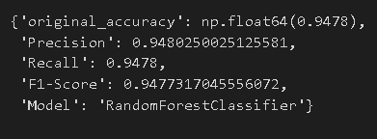
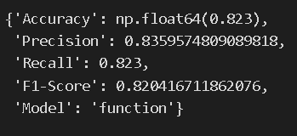
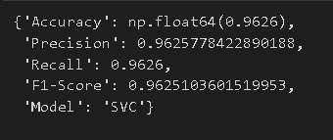
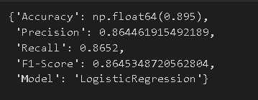
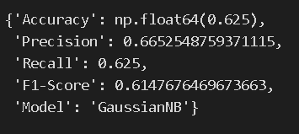
Results – Mnist
KNN

Slide 10
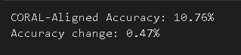
Results – Mnist(training)-> MnistM(testing)
Training on MNIST:
The model (RF/SVM) learns rules or hyperplanes based on clean, grayscale digits on white background.
For example: “if pixel (x, y) is dark, maybe it’s a 7.”
Testing on MNIST-M:
Input digits now have colored, textured backgrounds.
Pixel patterns are no longer consistent with what the model saw during training.
RF and SVM misfire on these unfamiliar pixel distribution
CORAL and MMD are loss functions used during training to align feature distributions of source and target domains. But models like Random Forest and SVM don’t use backpropagation, so they can’t minimize such losses.
That’s why CORAL and MMD are not directly effective for RF or SVM — they require a differentiable model like a neural network to learn domain-invariant features.

Slide 11
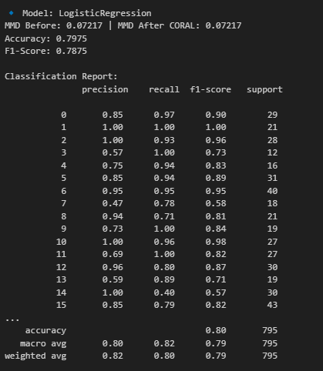
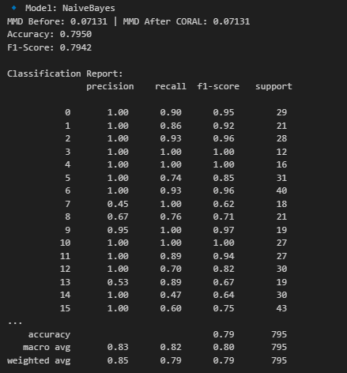
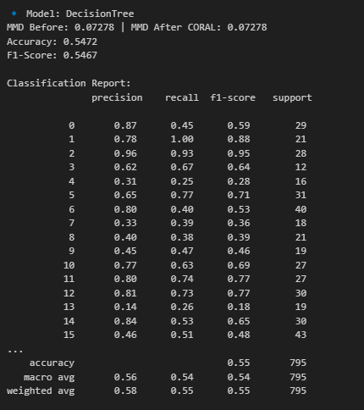
Results – Office 31

Slide 12
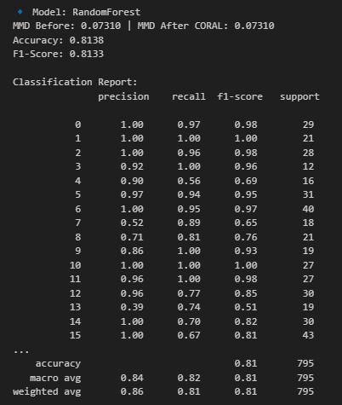
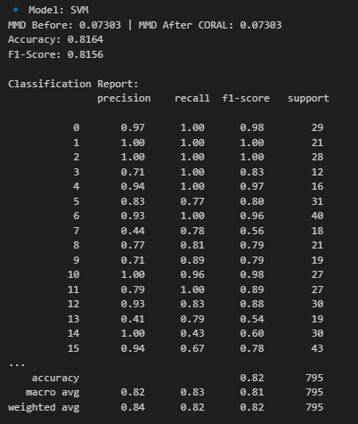
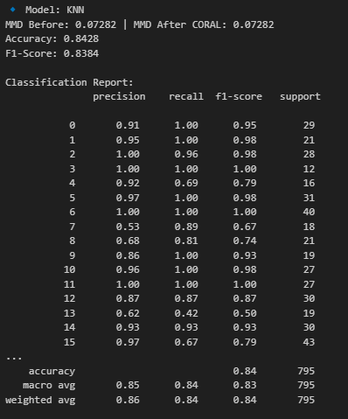
Result – Office 31

Slide 13
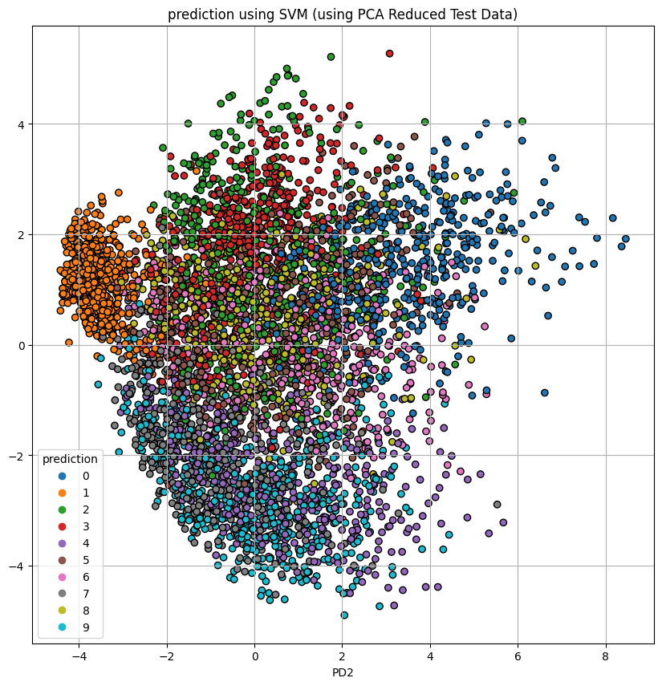
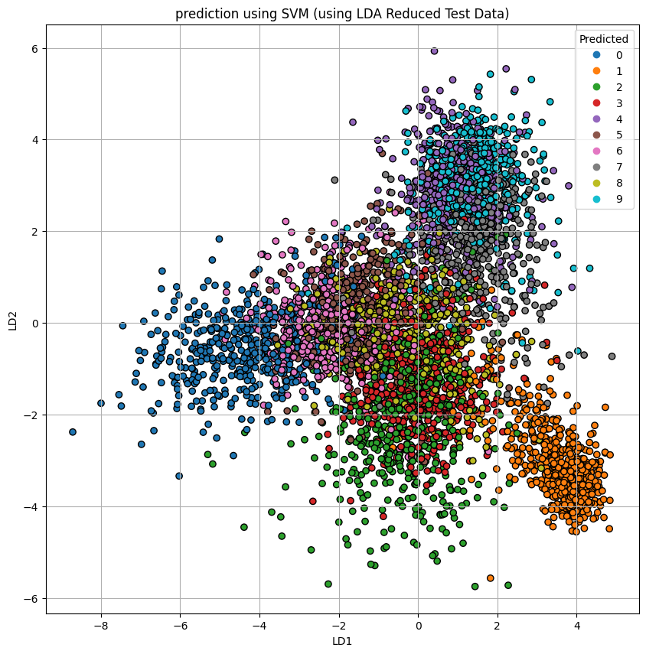
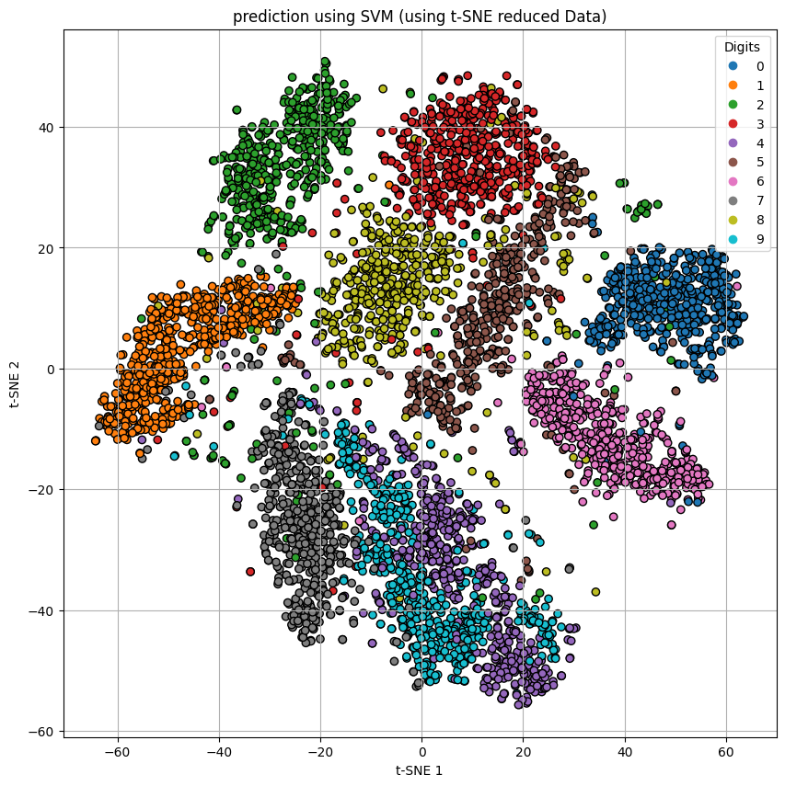
Visualization of Results – Mnist for PPT I am using results from SVM

Slide 14
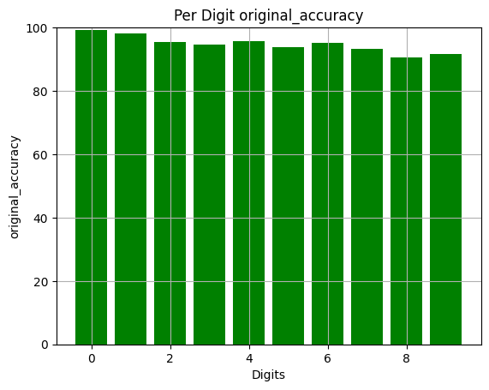
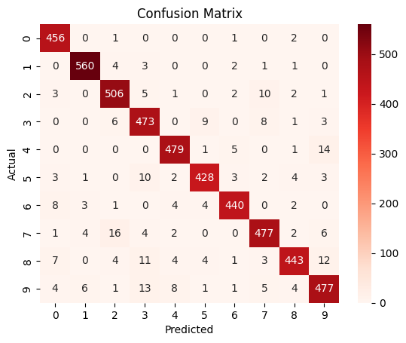
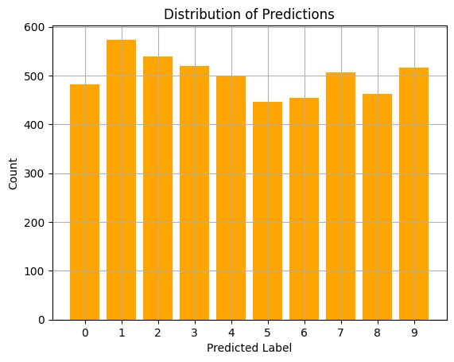
Visualization of Results MNIST for PPT I am using results from SVM

Slide 15
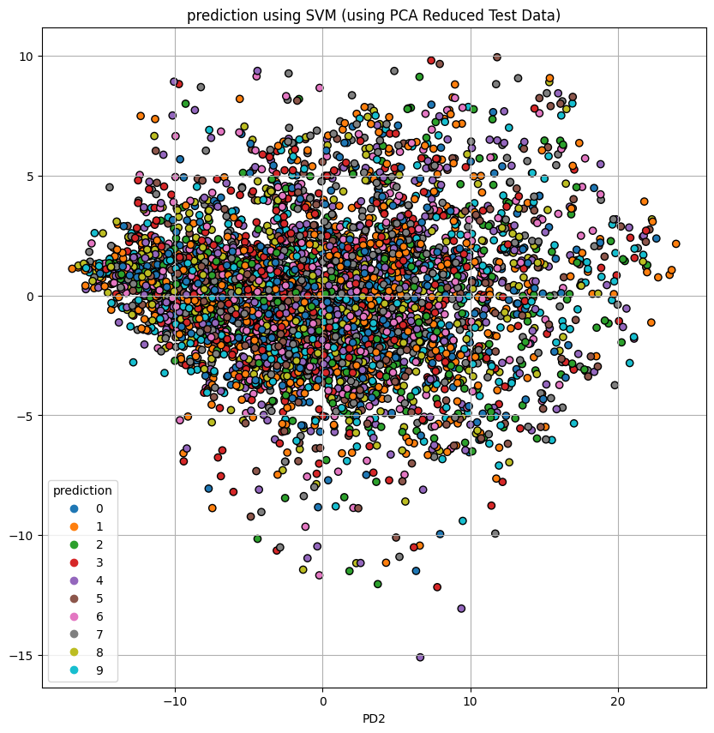
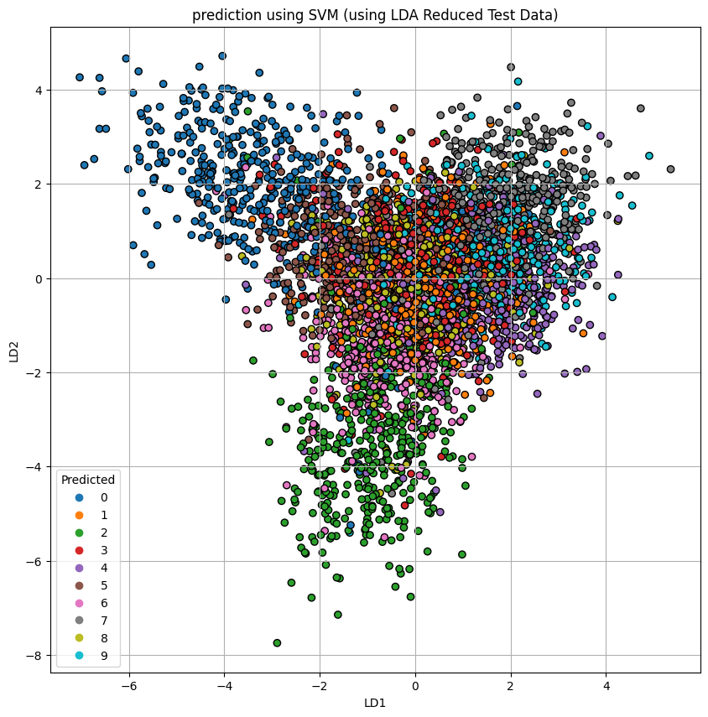
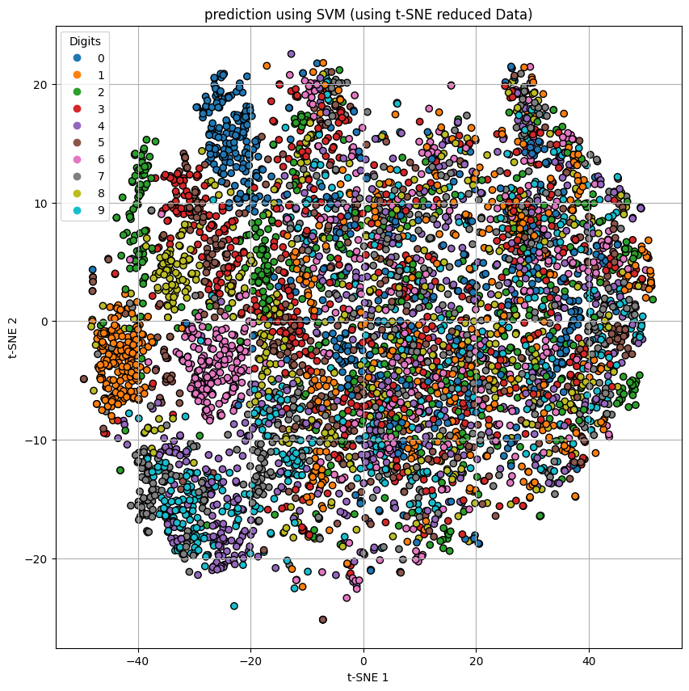
Visualization of Results – Mnist-M for PPT I am using results from SVM

Slide 16
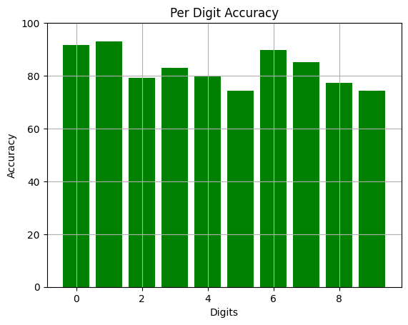
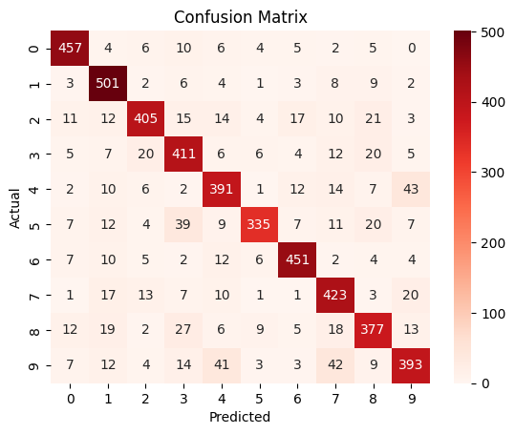
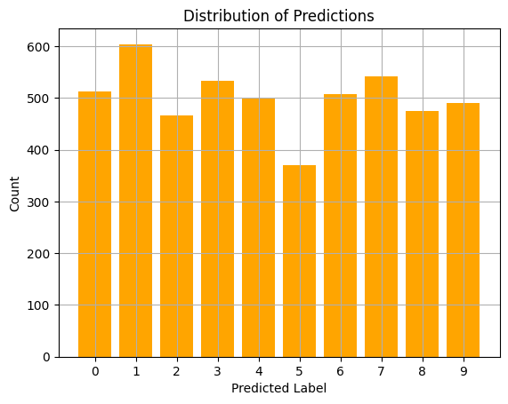
Visualization of Results – Mnist -M for PPT I am using results from SVM

Slide 17
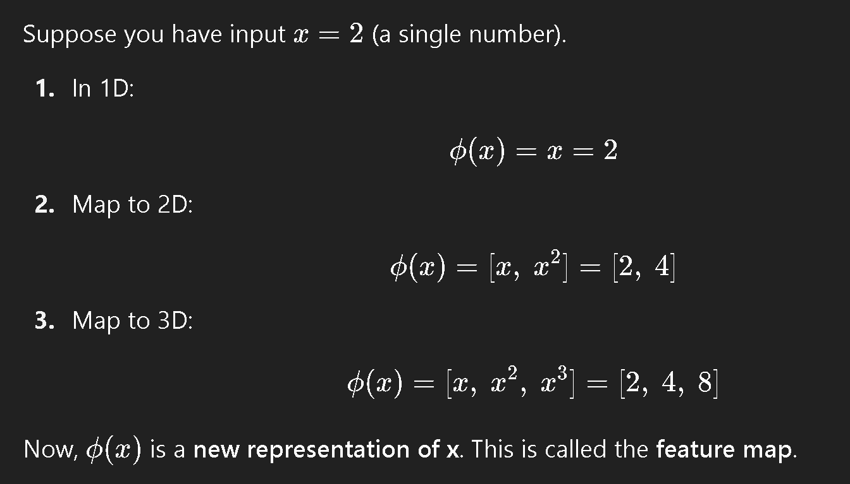
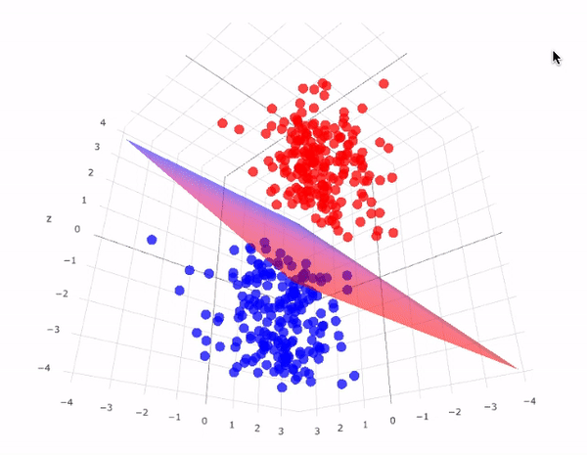
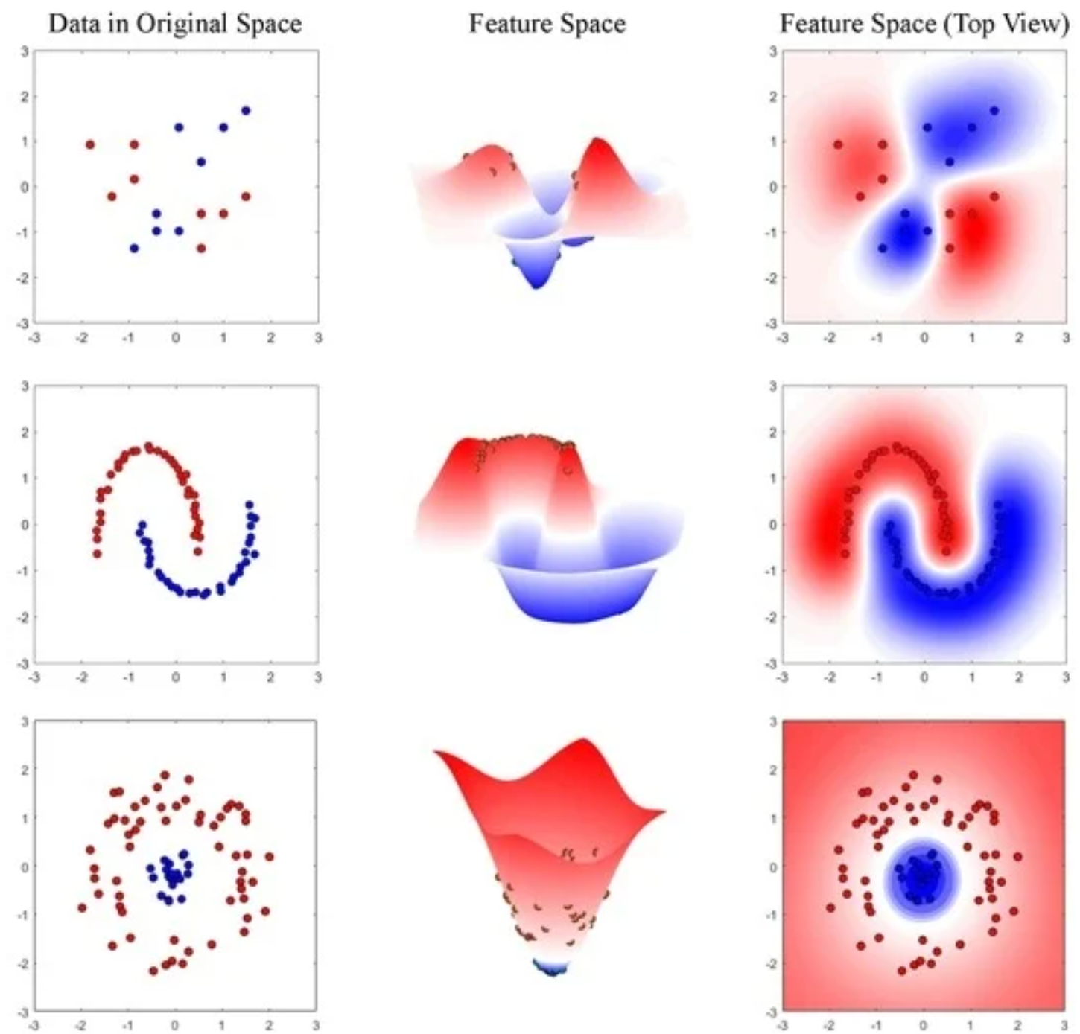
How does RBF Kernel Help here ?

Slide 18
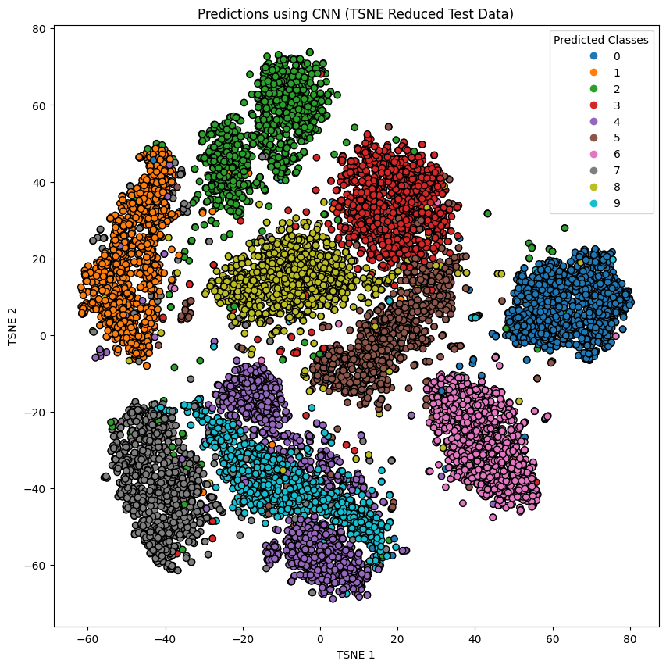
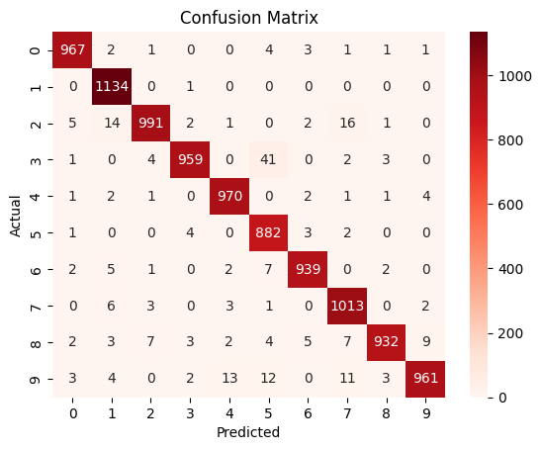
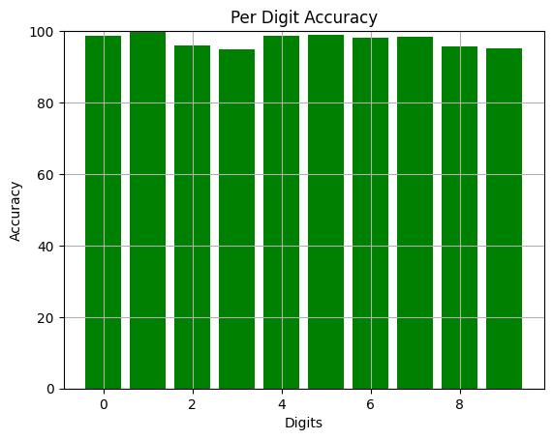
A results from CNN on MNIST-M
accuracy: 0.9551160931587219 = close to 95.5%

Slide 19
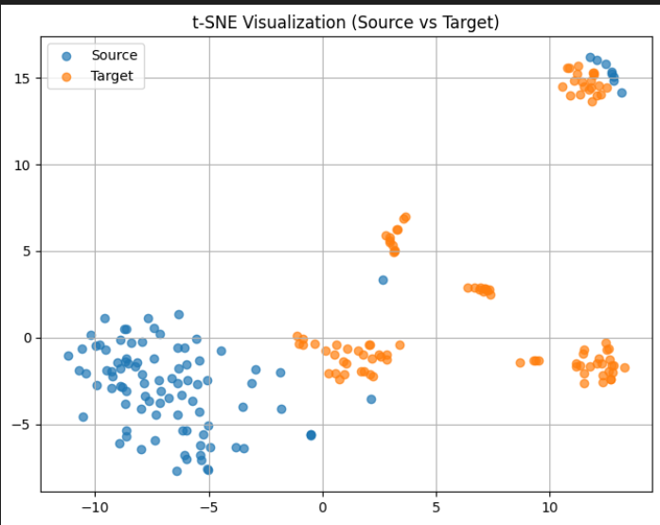
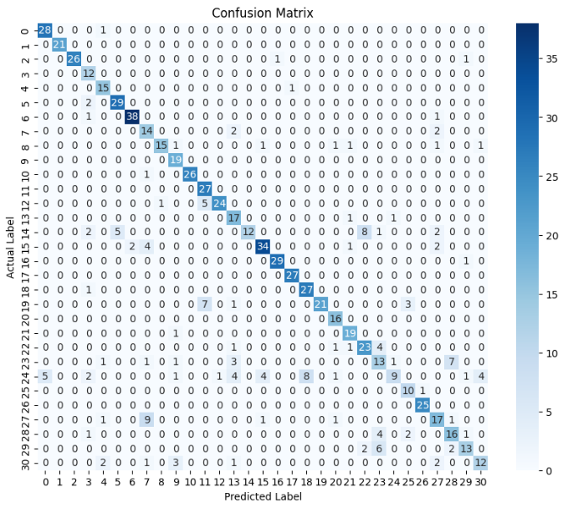
Result of Logistic Regression
office31_amazon_features V/S office31_webcam_features

Slide 20
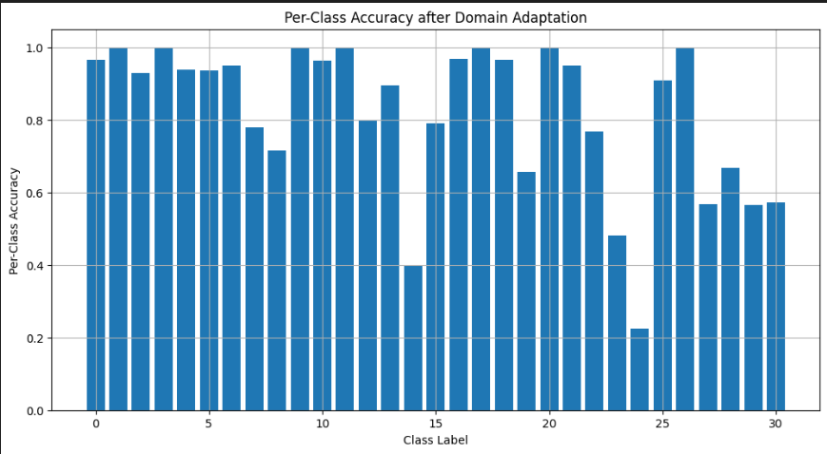
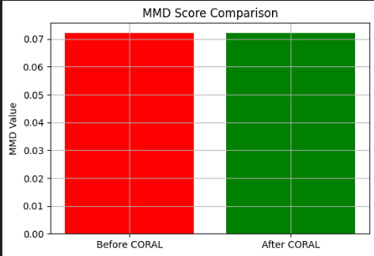
Result of Logistic Regression
office31_amazon_features V/S office31_webcam_features

Slide 21
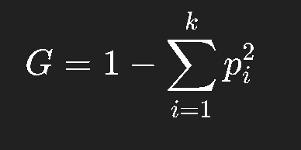
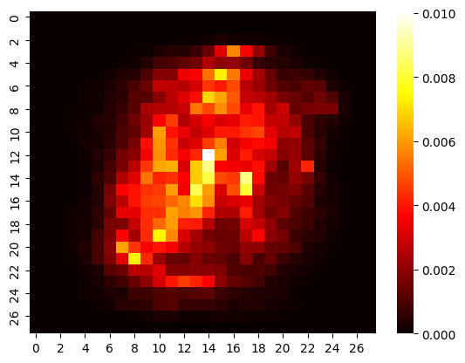
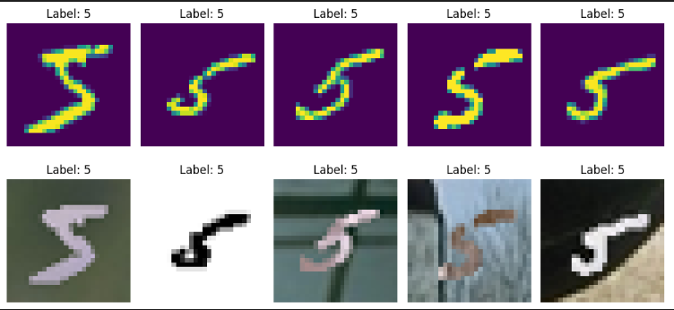
BUT WHAT IF TRAIN ON MNIST AND TEST ON MNIST-M ?

Slide 22
What is Coral ?
Our approach is in line with most existing unsupervised domain adaptation approaches in that we first transform the source data to be as close to the target data as possible. Then a classifier trained on the transformed source domain is applied to the target data

Slide 23
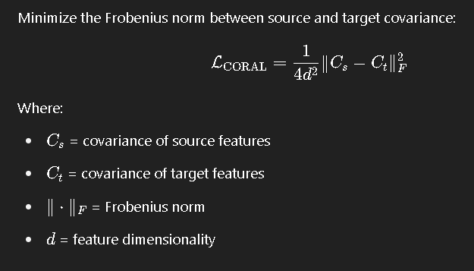
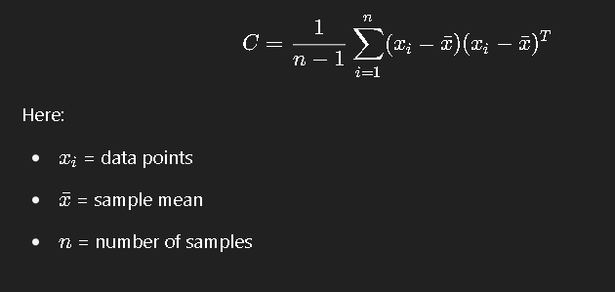
Our Aim :
CORAL aligns the input feature distributions of the source and target domains by minimizing the difference between their second-order statistics.

Slide 24
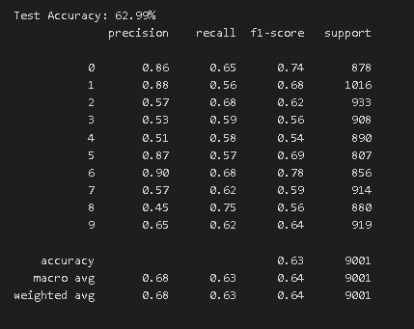
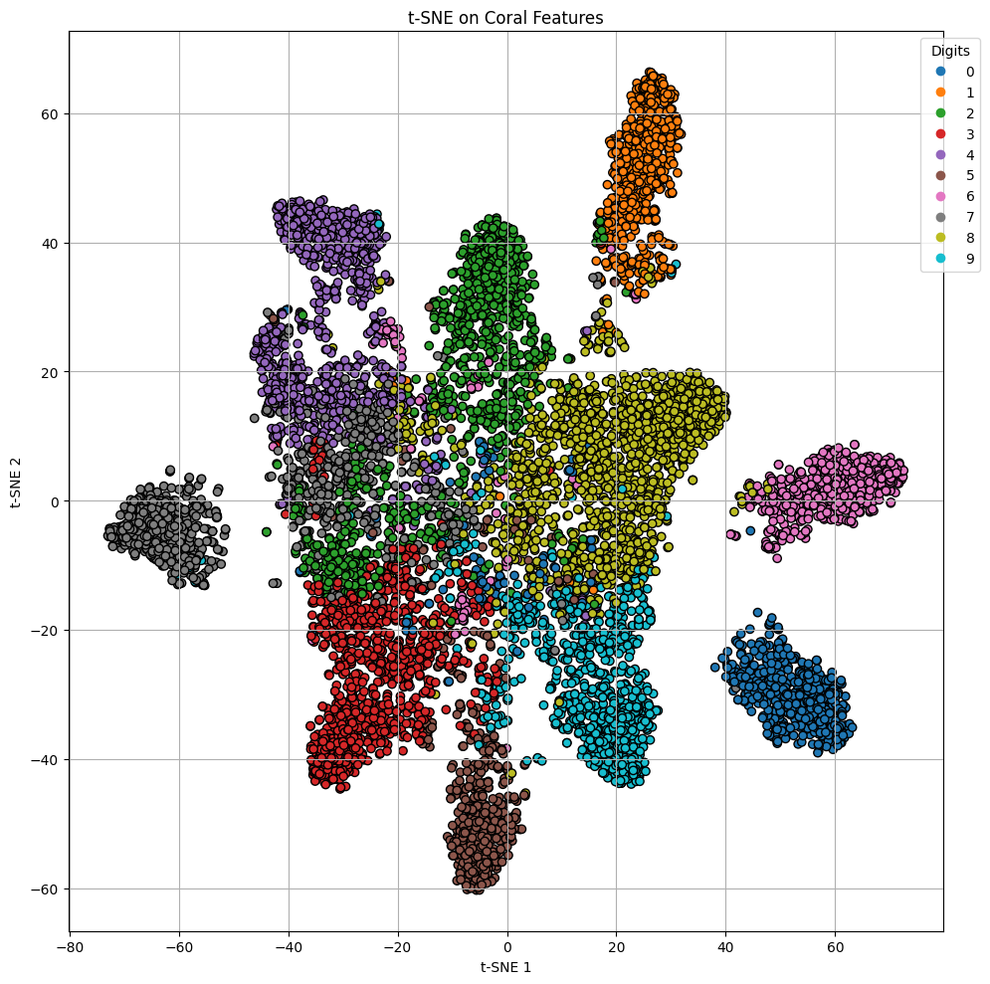
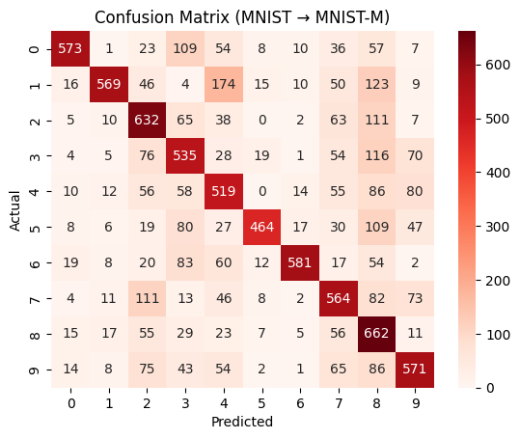
CNN With Coral Loss

Slide 25
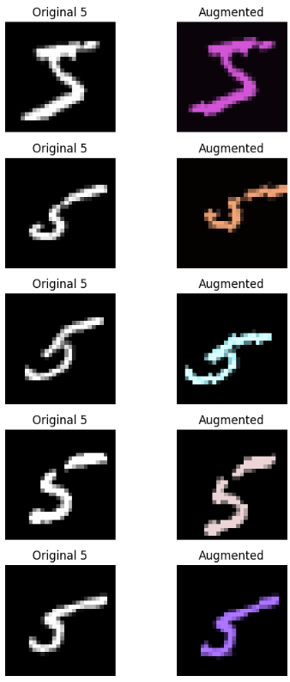



INNOVATIONS TRIED

Slide 26




Slide 27



Slide 28


Slide 29
Inferences Based on Mnist – M and Mnist
Random Forest clearly performed best with an 84% accuracy, making it the most reliable model the precision, recall, and F1-score were also consistently high, showing its strong generalization on MNIST-M.
SVM (SVC) performed the best with 87.5% accuracy, and through t-SNE and LDA plots, I clearly saw tight, well-separated clusters for digits, proving why SVC could classify so well.
SVM (SVC) followed closely with around 78% accuracy, and visually through t-SNE and LDA plots, I saw how SVM separated the digit clusters better than others but still had slight overlaps.
Random Forest and Logistic Regression were close behind with 84% and 83.9% accuracy, and PCA helped me see that Random Forest captured non-linear variations slightly better than Logistic Regression.
KNN showed 82.3% accuracy, doing decently, but t-SNE plots revealed that it struggled when digits like '3' and '8' overlapped in feature space.
Decision Trees and Logistic Regression had moderate performance (close to 61% and 50% accuracy) PCA plots helped me see that Decision Trees overfitted noise, and Logistic Regression struggled when the digit classes were not linearly separable.
Decision Trees and Naive Bayes underperformed (both around 62%-63% accuracy), and LDA visualization showed they couldn’t cleanly separate digit classes and overfitted or oversimplified patterns.
Naive Bayes performed quite poorly (close to 40% accuracy), and its LDA visualizations showed huge overlapping areas, meaning it couldn't model the complex pixel distributions of MNIST-M.
Comparing to MNIST-M, all models performed better on MNIST, and PCA showed that MNIST had simpler, less noisy feature distributions.
The KNN had around 10% accuracy and seemed to almost random guessing t-SNE helped me notice that it couldn't form meaningful clusters at all, just noisy blobs.
Metrics like Accuracy, Precision, Recall, and F1-score all aligned with what I observed visually: better separability and tighter clusters led to higher model performance on MNIST compared to MNIST-M.
Overall, by combining the metrics (Accuracy, Precision, Recall, F1) with PCA, LDA, and t-SNE visualizations, I could better understand not just "how much" each model was right but also "why" it struggled or succeeded based on the dataset’s feature separability.

Slide 30
Key Observations on Mnist – M and Mnist using a Results Table
I observed that KNN performed very well on the MNIST dataset but struggled when I tested it on the MNIST-M dataset, showing that KNN is sensitive to domain shifts like background changes.
Model | MNIST Accuracy | MNIST-M Accuracy | Key Observations
Decision Tree | 63.5% | 61.9% | Slightly better on MNIST overfitting seen in both (PCA showed scattered points).
KNN | 82.3% | 10% | Huge drop in MNIST-M t-SNE showed no clear clusters for MNIST-M.
Logistic Regression | 86.45% | 61.7% | Strong on MNIST struggled with noisy backgrounds in MNIST-M (seen in LDA).
Naive Bayes | 62.5% | 42.9% | Bad for both, worse for MNIST-M LDA showed overlapping digit classes.
Random Forest | 94.7% | 84.1% | Consistently high , performs well handled noise in MNIST-M well
SVM (SVC) | 96.26% | 78.2% | good performer overall tighter clusters visible in t-SNE and LDA for MNIST.
While working on MNIST-M using CNN, I was able to achieve an accuracy of 95.5%. I visualized the features using t-SNE, where I saw that the digits formed distinct, well-separated clusters. The confusion matrix showed that most predictions were accurate, with very few mistakes across classes. I also plotted per-digit accuracy, and I noticed that all digits had accuracies between 90% and 100%
From CNN

Slide 31
Inference (Based on Results) – Office 31
FOR t-SNE Visualisation (Source vs Target)
Clusters are somewhat separated → domain shift still exists between Source and Target even after PCA.
Some overlapping → CORAL + PCA helped a bit, but not fully aligned.
Better overlap → better domain adaptation → higher accuracy.
FOR Confusion Matrix
Diagonal line is strong and dominant → most classes are classified correctly.
Some minor off-diagonal errors → specific classes are confusing for the model.
No major misclassifications across distant classes → Model is reasonably good after domain adaptation.

Slide 32
Inference (Based on Results) – Office 31
FOR Per-Class Accuracy Bar Plot
Most classes achieve close to 80% accuracy.
Few classes have lower accuracy (around label 16, 24, 29, etc.)
Some classes are harder to adapt, possibly because their feature distributions shifted more heavily.
FOR MMD Score Comparison
Small reduction in MMD (from ~0.072 ➔ ~0.070).
CORAL helped align domains a little bit, but not dramatically.
Domains are still moderately different even after adaptation.

